Slide 1
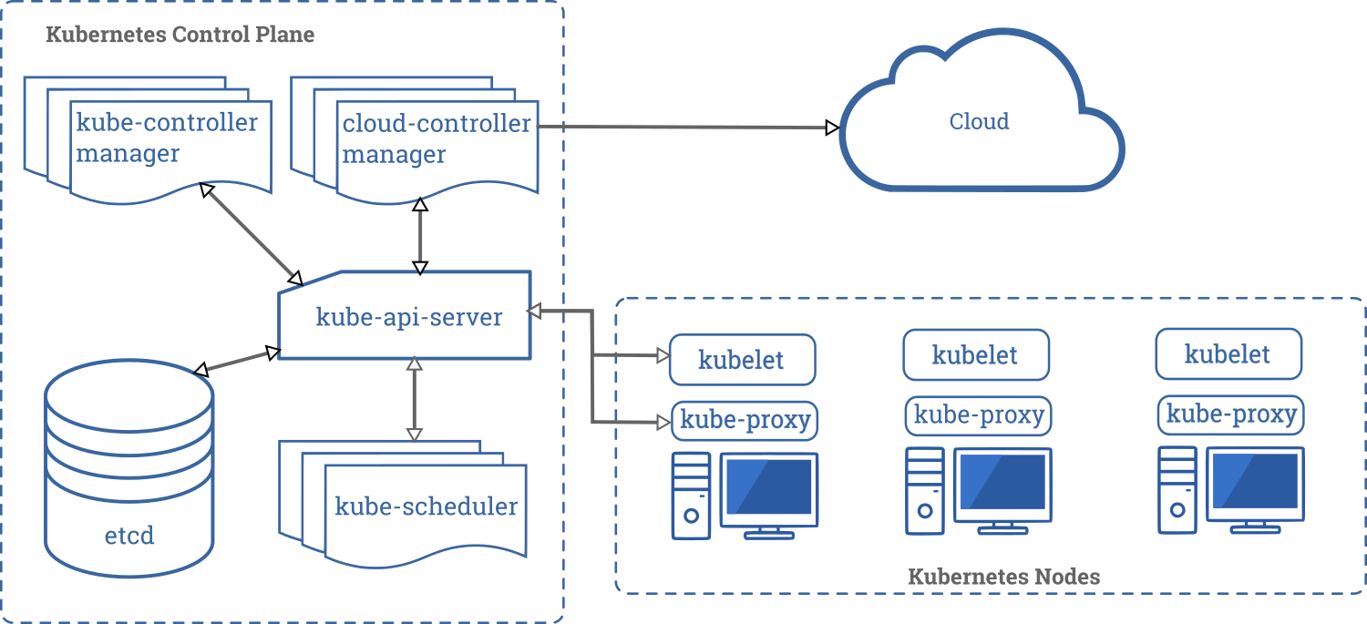
Etcd is the source of truth for application configs and secrets
ConfigMaps and secrets are stored in etcd; injected into running containers via environment variables or volume mounts.

Slide 2
Kubernetes ConfigMap and Secrets
Pros
Cons
pod/container won’t start if etcd is down, thus app will have its config on startup.
Programming language neutral, not Java or Spring centric.
Very nice Spring integration with Spring cloud Kubernetes projects.
Can only store the latest version of configuration; no auditing of previous versions of a config value.
Requires developers to be familiar with Kubernetes.
Requires application to run on Kubernetes.
ConfigMap is not available when launching a Spring app from IDE on laptop.
May require access to the Kubernetes API server to be able to watch for changes on the ConfigMap so that apps can reload.
Multiple apps will have multiple ConfigMap YAML files in multiple K8S namespaces, making it hard to see all the config in one place.
Works inside a single K8S cluster; ConfigMap does not span clusters or namespaces.

Slide 3
Spring Cloud Config Server vs. Kubernetes ConfigMap & Secrets
Config Server
ConfigMap / Secrets
Pros
Versioned/audited history of configuration settings.
Pluggable external stores (vault, sqldb, other config servers).
Runs locally; no developer desktop directly from IDE.
Does not depend on Kubernetes; developer does not need to know anything about K8S to use config server.
Store configurations for multiple apps in one config server.
Config backed up outside of Kubernetes cluster.
Defines a hierarchy of property sources; allows extraction into a common property file in the config server.
Can be used outside of K8S or in a multi-cluster configuration.
Pros
Pod/container won’t start if etcd is down, thus app will have its config on startup.
Programming language neutral, not Java or Spring centric.
Very nice Spring integration with Spring cloud Kubernetes projects.
Cons
Can only store the latest version of configuration; no auditing of previous versions of a config value.
Requires developers to be familiar with Kubernetes.
Requires application to run on Kubernetes.
ConfigMap is not available when launching a Spring App from IDE on laptop.
May require access to the Kubernetes API server to be able to watch for changes on the ConfigMap so that apps can reload.
Multiple apps will have multiple ConfigMap YAML files in multiple K8S namespaces, making it hard to see all the config in one place.
Works inside a single K8S cluster; ConfigMap does not span clusters or namespaces.
Cons
Application can’t startup if config server is down.
Application must understand the config server REST API or use a client library.
Considered Java/Spring centric by other language communities.

Slide 4
What if we can have all the pros of the Spring Cloud Configuration Server, ConfigMaps, and Secrets without the cons? We can use the Application Configuration Service on Azure Spring Apps Enterprise

Slide 5
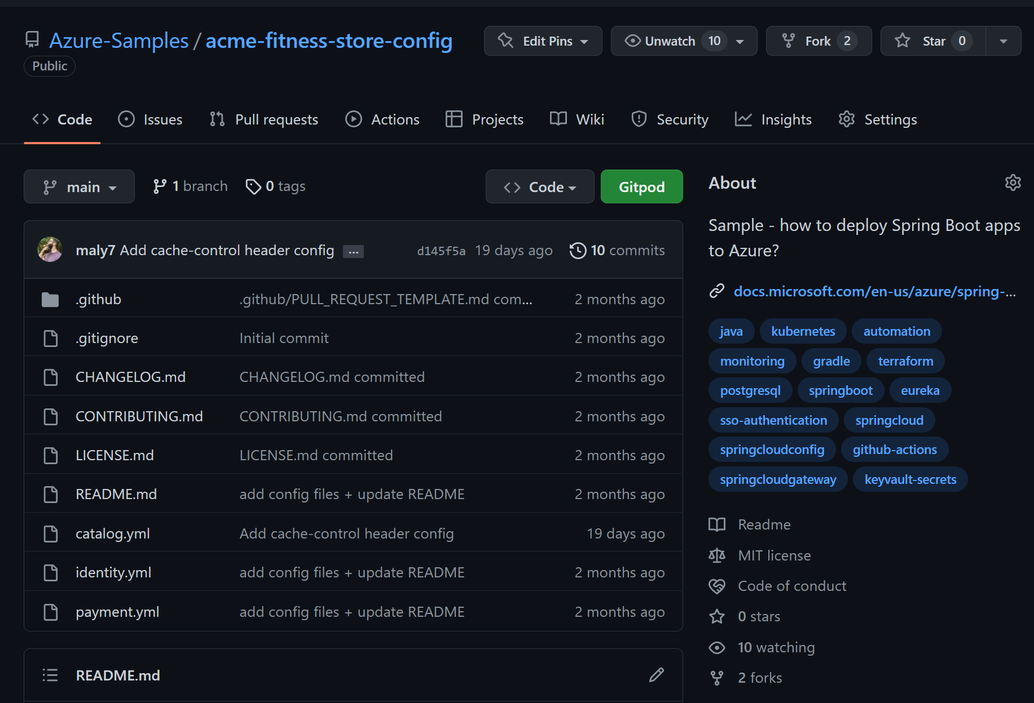
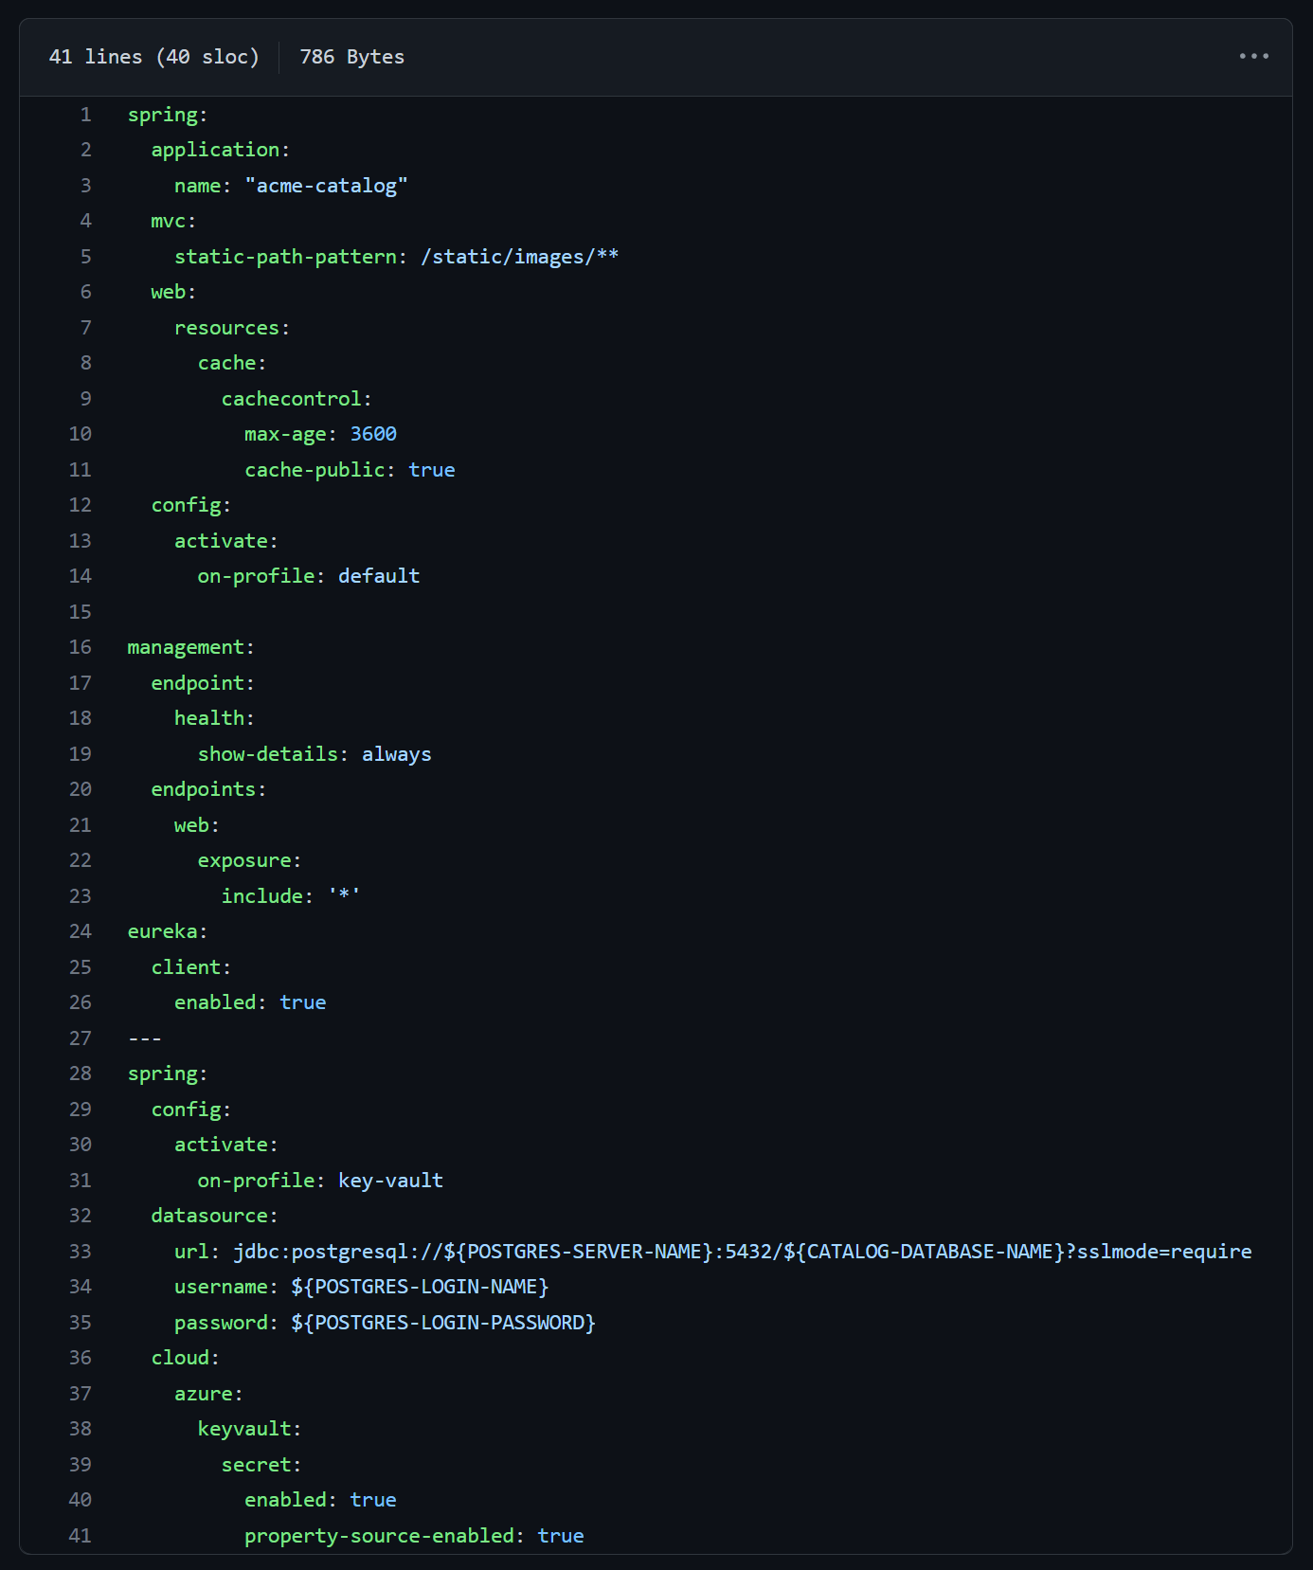
Spring configuration in Git repos
Notes:
Spring Apps applications typically externalize their configuration into a git repository and access the configurations using Spring Apps config server and associated client libraries.

Slide 6
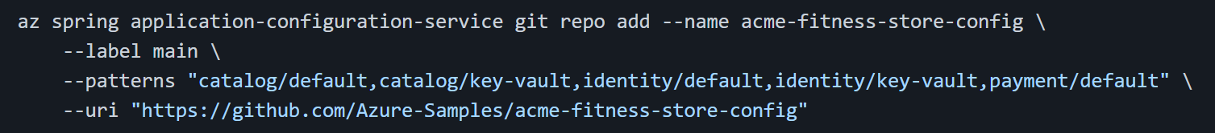
Spring configuration in Git repos
Automatically mounted as volumes in the underlying Kubernetes cluster
A simple command
Consumes config files in the Git repo.
Makes them accessible to the app as ConfigMap mounted as a volume.
Spring Boot automatically processes mounted volumes.
Notes:
The Application configuration service is a feature of Azure Spring Apps Enterprise that makes Spring Apps config server capabilities available in a polyglot way.
Application configuration service works by pulling configuration settings from a git repo and turning them into Kubernetes ConfigMaps that are then mounted as volume in the running container.
Spring Boot knows how to read the contents of the configuration settings automatically.
There are two benefits to the application configuration service:
First, you can remove the Spring Apps config server jars from the application’s classpath.
Second, if you have a non-Spring-based App that you are deploying, you can easily access its configuration without needing a custom library in the specific programming language.

Slide 7

Demo 3 Deploy backend API
Deploy Catalog backend API
Application Configuration Service

Slide 8

Application Configuration Service vs. Spring Cloud Config Server
Application Configuration Service preserves the behavior of the Spring Cloud Config Server.
Polyglot-friendly does not require any client library in the application code.
Spring Cloud Config is available on the Azure Spring Apps basic and standard tiers.
Application Configuration is only available on the enterprise tier.

Slide 9
Service registration & discovery
5 mins
Notes:
Speaker: Asir

Slide 10

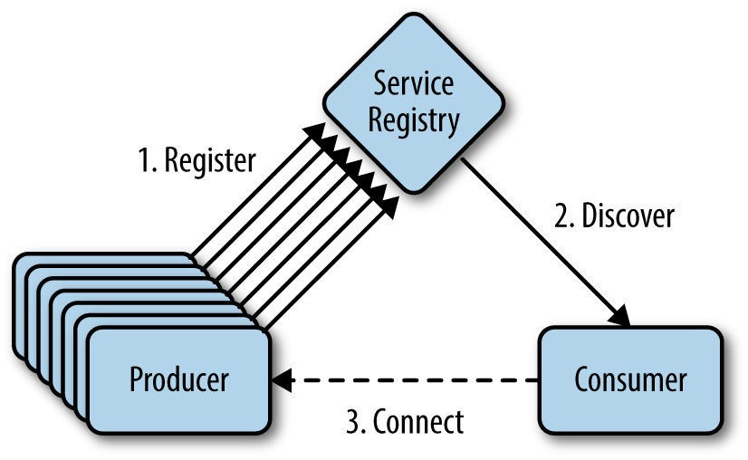
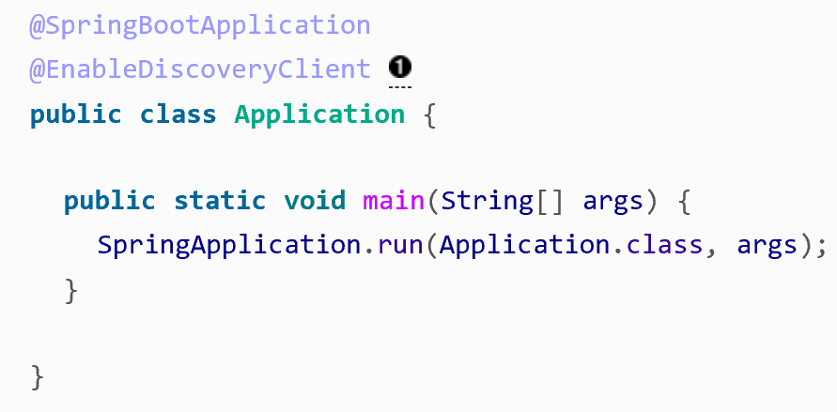
Spring Cloud Service Registry
No more code or URL dependencies
How can all apps within a composed system talk to each other?
Common pattern – frontend services talk to backend services.
Service Registry:
Maintains list of services to call.
Provides libraries for routing and load balancing.
Leverages Netflix Eureka.
A Spring Boot App can participate in service registration and discovery simply by adding the @EnableDiscoveryClient annotation.
Notes:
No more code or URL dependencies.
Think about apps talking to each other. Should they call each other using URLs with address and port numbers? No.
Use Service Registry magic.
A Spring Boot App can participate in service registration and discovery simply by adding the @EnableDiscoveryClient annotation.

Slide 11
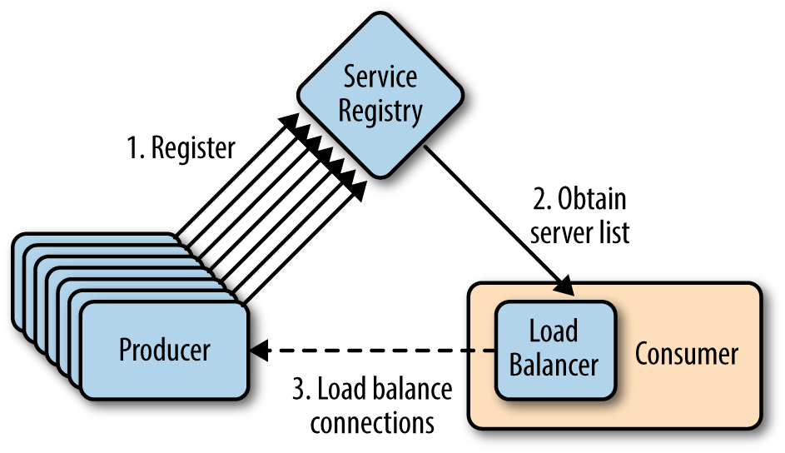
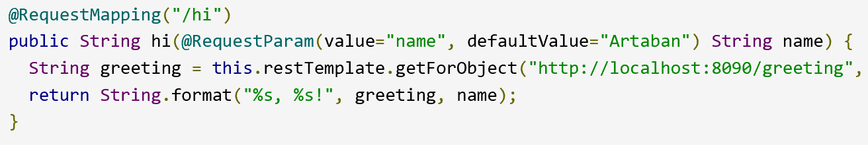
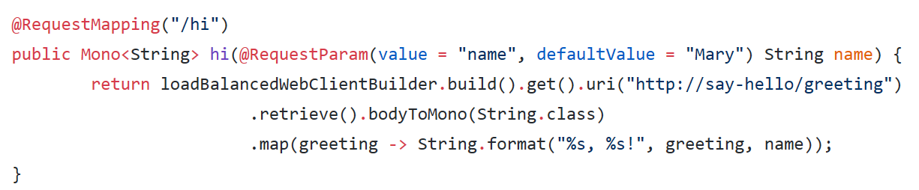
Spring Cloud Load Balancer (client-side)
One app wants to call another app, looks up the service registry, returns all the instances of the called app, caller service headache for which instance it calls.
Moves beyond a single hard-coded server URL to a load-balanced solution.
Provides client-side load balancing in calls to another app.
Distributed systems demand an advanced set of routing and load balancing behaviors for app-to-app communications.
Notes:
Client-side load balancing.
Say you are looking for a dentist in the Yellow Pages; you will find many listings.
Similarly, if you have many service app instances, one app wants to call another. This is where the load balancer comes into play .. It will look up the service registry and pick one of the instances to call.
You can see how you no longer have to hardcode any URLs.

Slide 12
Lab 3 Deploy end-to-end
Create backend API apps
Bind apps to Config and Service Registry
Deploy all backend APIs
Configure Spring Cloud Gateway
Test the full app
Explore API Portal
45 mins

Slide 13
Managing secrets using Key Vault
10 mins

Slide 14


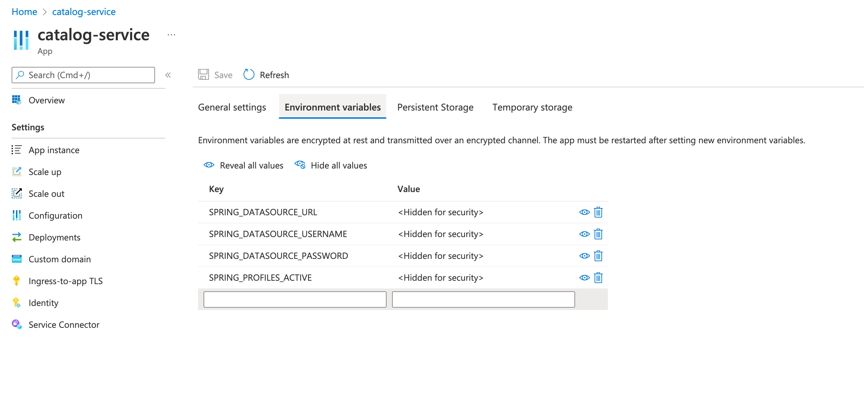



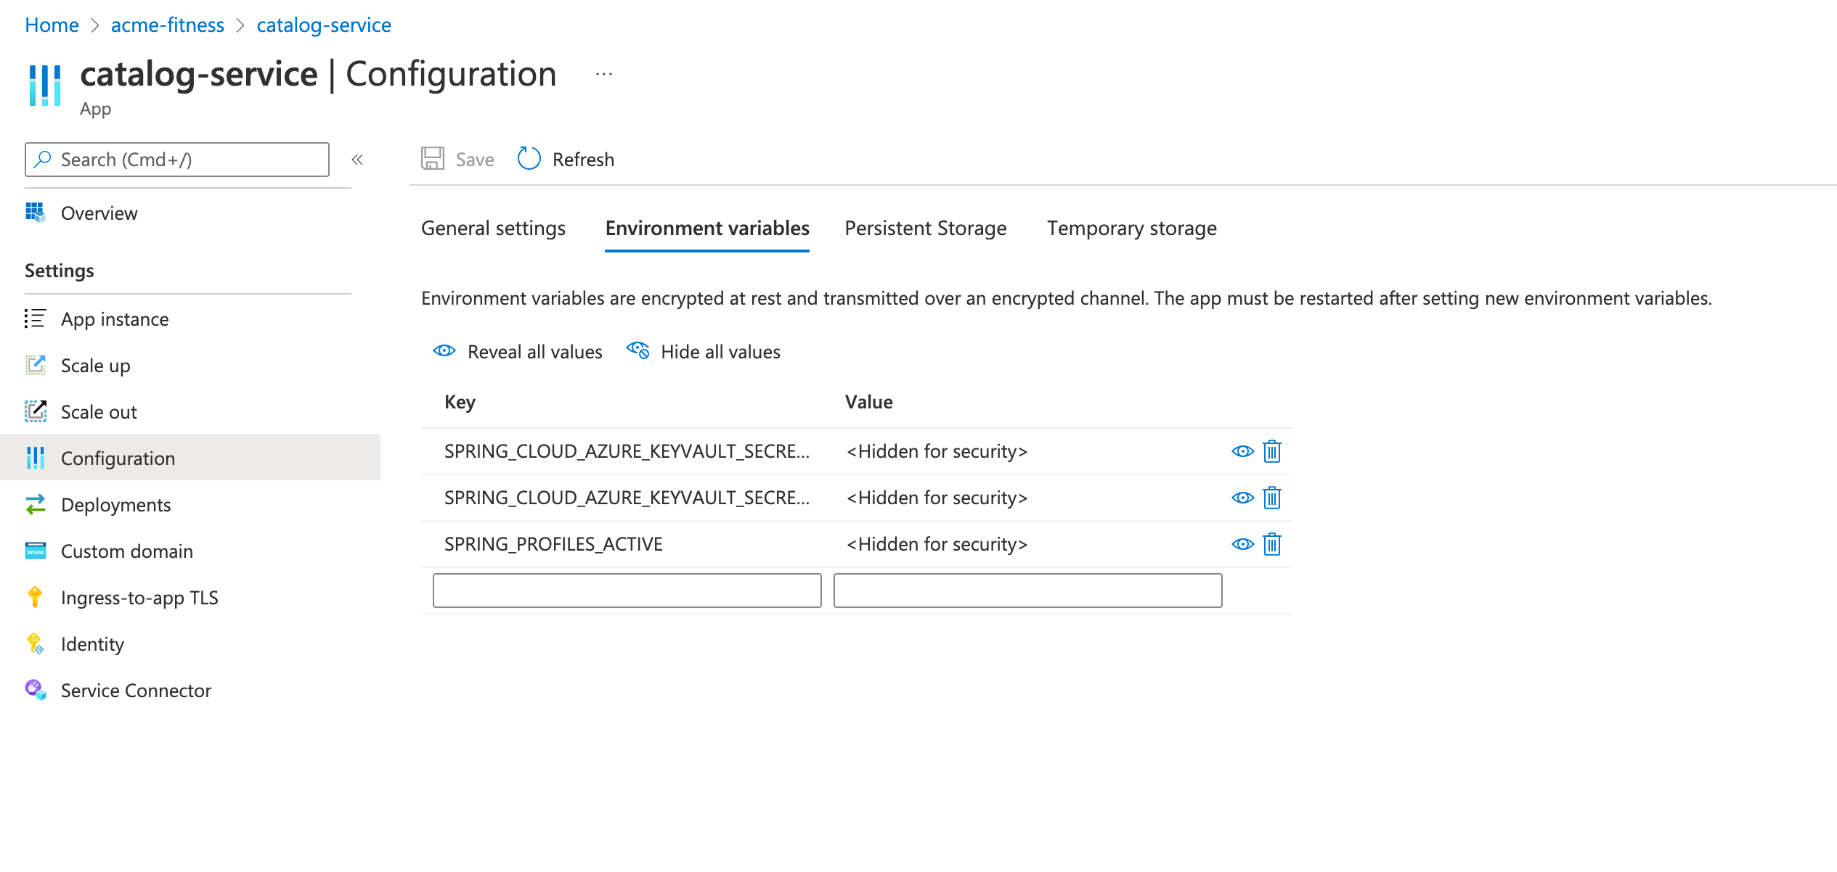

Zero Trust – Manage Secrets using Key Vault
Control distribution of secrets to reduce accidental leakage.
Applications can securely access secrets.
Control RBAC to Key Vault – security admin and others.
Azure Key Vaults may be software- or hardware-enabled.
Monitor access and use of secrets in Key Vault.
App
Azure Key Vault
Administrator
Developer, SRE, DevOps…
Azure Active Directory
Security Administrator
Control distribution of secrets to reduce accidental leakage.
Applications can securely access secrets.
Control RBAC to Key Vault – security admin and others.
Azure Key Vaults may be software- or hardware-enabled.
Monitor access and use of secrets in Key Vault.
Notes:
On this screen, we have two examples of the “backend” app.
Every application has properties that connect it to its environment and supporting services, things like databases, logging and monitoring tools, messaging platforms, and many other things. Each requires a way to locate and access it, often in the form of URLs and credentials ... and if exposed, that critical information can be used to access key customer data. Even if this data wasn’t protected by law – and it is in nearly all parts of the globe, for a very good reason – protecting customer data from leakage should still be of the utmost importance to all of us.
Since applications need that information to operate, the first step app developers usually take is to embed it within the app itself. This is a huge security risk for many reasons, not the least of which is that it is nearly inevitable that it will eventually slip through and be committed to a code repository, making it prone to discovery.
To increase application scalability, app devs typically move on to externalizing key data values and credentials so that multiple instances of the same application can load the same values, dynamically refreshing when they are updated. This only shifts the risk from the code to the execution environment. In the left portion of the screen is an example of the customers service that uses environment variables for key credentials.
Azure Key Vault provides a better, safer, and much more secure way to manage secrets. With Azure Key Vault:
You control storage and distribution of application secrets to reduce accidental leakage.
Applications can securely access credentials.
Key Vault uses Role-Based Access Control (RBAC) to lock down access to only those requiring access: admins of course, but also apps, using the principle of least privilege.
Authentication and Authorization use Azure Active Directory and Azure RBAC.
Azure Key Vaults may be software- or hardware-protected.
And of course, you can monitor the access and use of secrets in Key Vault, with a full audit trail.

Slide 15

Managed Identities for Azure Resources
Gives your Azure resource an identity on Azure Active Directory.
A system managed identity will help you as follows:
Eliminate the need for credentials in your code.
Rotate credentials automatically.
Reduce your involvement in managing identities to a minimum.
A user assigned identity:
Can be reused.
Must be managed by you.

Slide 16
Azure role-based access control (RBAC)
What can I do with Azure RBAC? Some examples:
Allow one user to manage virtual machines.
Allow a DBA group to manage the Azure SQL databases.
Allow an application to access resources in a resource group.
Security principal:
User
Group
Service Principal
Managed Identity
Roles

Slide 17

Azure Key Vault
What does Azure Key Vault deliver?
Secrets management
Key Management
Certificate Management
Stores secrets backed by Hardware Security Modules
Demo uses:
Spring Boot Key Vault starter.
System assigned Managed Identity for application.
Access policies or RBAC on Key Vault to allow application access.
Azure Key Vault to get application configuration (using secrets).

Slide 18

Demo 4 Manage secrets
Configure Catalog app to securely load passwords

